Slide 1
Chapter 5
The Laws of Motion

Slide 2
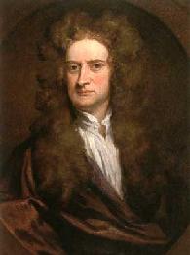
The Laws of Motion
Newton’s first law
Force
Mass
Newton’s second law
Newton’s third law
Examples
Isaac Newton’s work represents one of the greatest contributions to science ever made by an individual.
Notes:
2

Slide 3
Dynamics
Describes the relationship between the motion of objects in our everyday world and the forces acting on them
Language of Dynamics
Force: The measure of interaction between two objects (pull or push). It is a vector quantity – it has a magnitude and direction
Mass: The measure of how difficult it is to change object’s velocity (sluggishness or inertia of the object)
Notes:
3

Slide 4
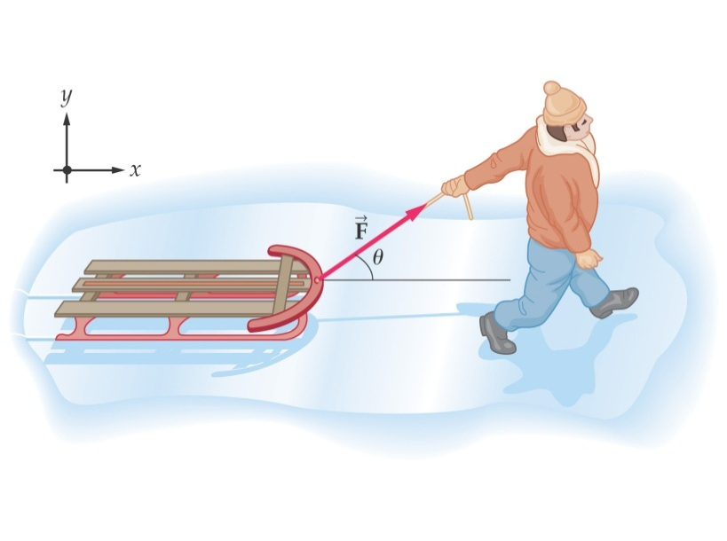
The Concept of Force
Forces in everyday experience
Push or pull on an object to move it
Throw or kick a ball.
In these examples the word force refer to an interaction with an object by means of muscular activity and some change in the object’s velocity.
Forces are what cause any change in the velocity of an object.
Newton’s definition
A force is that which causes an acceleration
Section 5.1

Slide 5
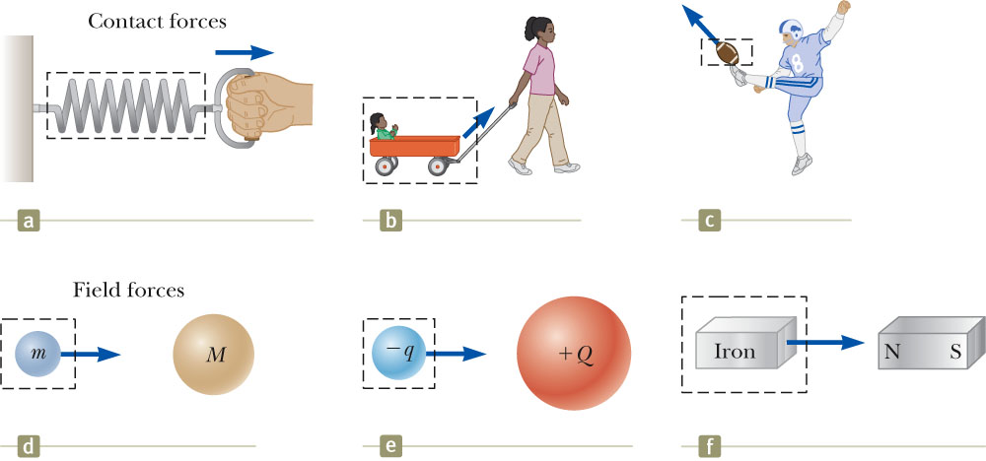
Classes of Forces
Contact forces involve physical contact between two objects
Examples a, b, c
Field forces does not involve physical contact between two objects they act through empty space
Examples d, e, f
Section 5.1

Slide 6
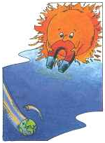
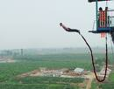
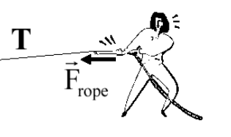
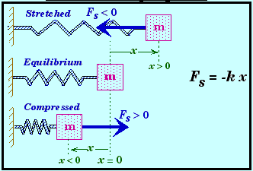
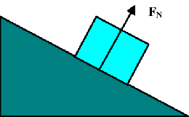
Forces
Gravitational Force
Archimedes Force
Friction Force
Tension Force
Spring Force
Normal Force
Notes:
6

Slide 7
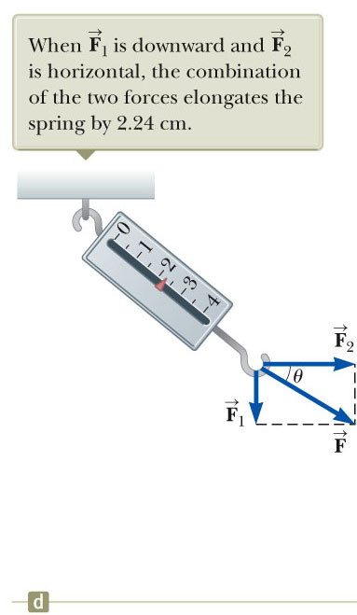
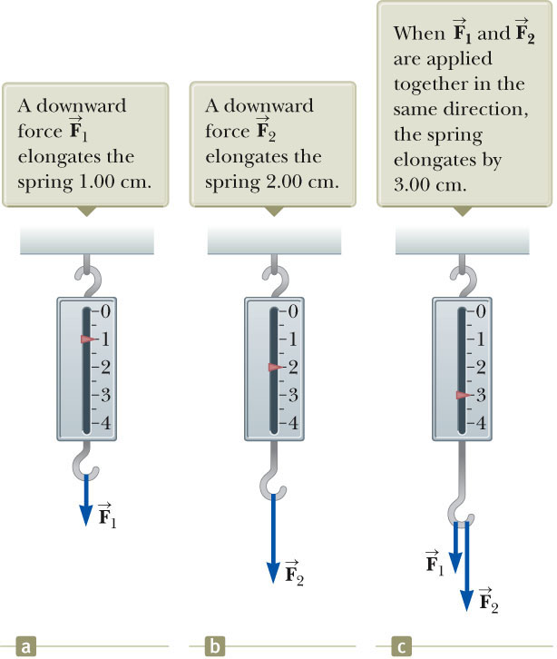
Vector Nature of Force
Vector force: has magnitude and direction
Net Force: a resultant force acting on object
You must use the rules of vector addition to obtain the net force on an object
Notes:
7

Slide 8
Newton’s First Law
In the absence of external forces and when viewed from an inertial reference frame, an object at rest remains at rest and an object in motion continues in motion with a constant velocity (that is, with a constant speed in a straight line).
In other words, when no force acts on an object, the acceleration of the object is zero.
In conclusion an accelerating object must be experiencing a force.
Or force as that which causes a change in motion of an object.
Section 5.2

Slide 9
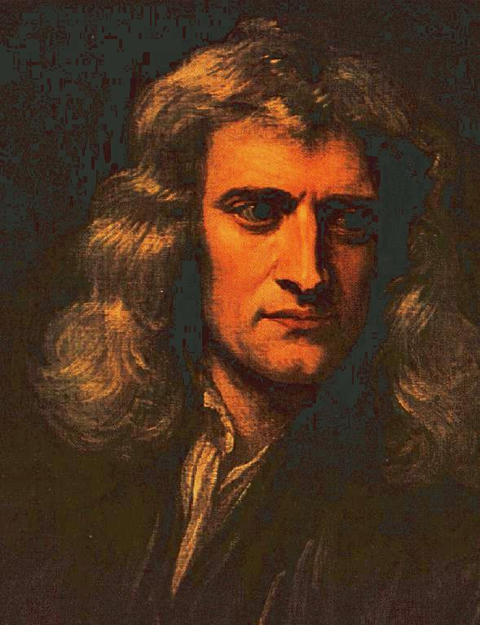
Newton’s First Law
An object at rest tends to stay at rest and an object in motion tends to stay in motion with the same speed and in the same direction unless acted upon by an unbalanced force
When forces are balanced, the acceleration of the object is zero
Object at rest: v = 0 and a = 0
Object in motion: v ≠ 0 and a = 0
Notes:
9

Slide 10
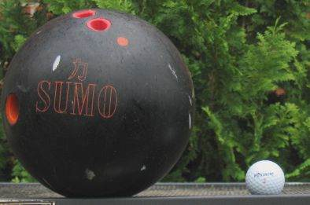
Mass and Inertia
Inertia is a property of objects
to resist changes is motion!
Mass is a measure of the
amount of inertia.
Mass is a measure of the resistance of an object to changes in its velocity
Mass is an inherent property of an object
Scalar quantity and SI unit: kg
Notes:
10

Slide 11
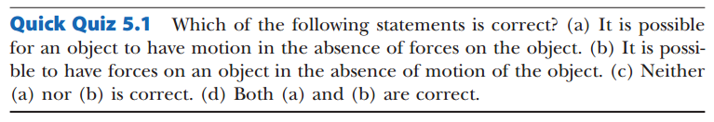

Slide 12
Mass vs. Weight
Mass and weight are two different quantities.
Weight is equal to the magnitude of the gravitational force exerted on the object.
Weight will vary with location.
Example:
w_{earth} = 180 Newton ; w_{moon} ~ 30 Newton
m_{earth} = 2 kg; m_{moon} = 2 kg
Section 5.3

Slide 13
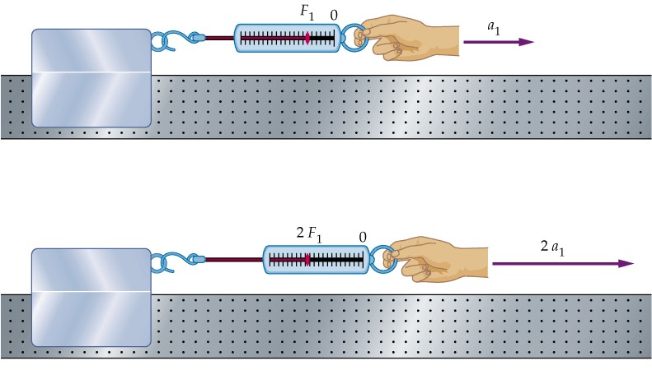
Newton’s Second Law
The acceleration of an object is directly proportional to the net force (Sum of Forces) acting on it and inversely proportional to its mass
Notes:
13
Newton’s first law explains what happens to an object when no forces act on it: it either remains at rest or moves in a straight line with constant speed. So, what will happen to an object if the net force is not zero? Newton’s 2nd law answers this question.
The force will change the motion of the object and create an acceleration. Newton’s 2nd law states the acceleration of an object is directly proportional to the net force acting on it and inversely proportional to its mass.
Let’s take a look of this experiment: imagine pull a block of mass across a frictionless horizontal surface. When we exert F1 on the block, it moves with an acceleration of a1. If we apply a force twice as great on the same block, the acceleration doubles. If we increase force to 3F1, the acceleration triples.

Slide 14
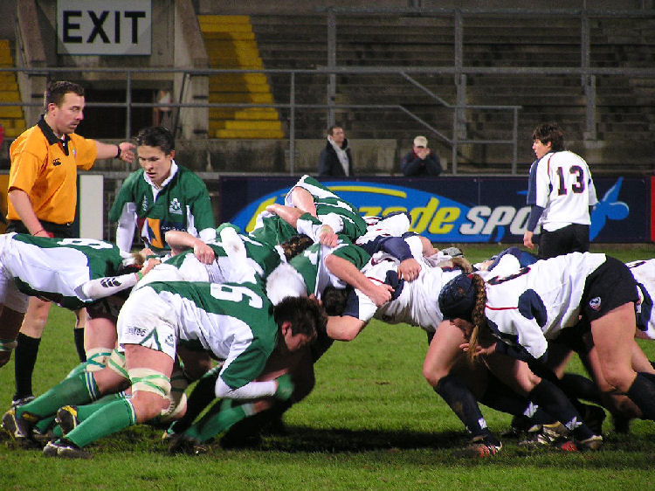
More About Newton’s Second Law
is the net force
This is the vector sum of all the forces acting on the object.
May also be called the total force, resultant force, or the unbalanced force.
Newton’s Second Law can be expressed in terms of components:
Remember that ma is not a force.
The sum of the forces is equated to this product of the mass of the object and its acceleration.
Section 5.4

Slide 15
Units of Force
The SI unit of force is the newton (N).
1 N = 1 kg·m / s²
The US Customary unit of force is a pound (lb).
1 lb = 1 slug·ft / s²
1 N ~ ¼ lb
Section 5.4

Slide 16
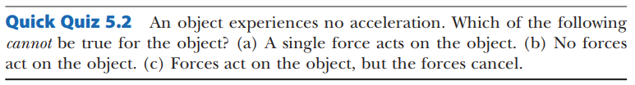

Slide 17
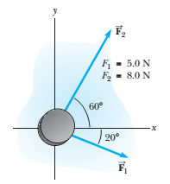
Problem 5.1 An Accelerating Ice Hockey Disk
A hockey disk having a mass of 0.30 kg slides on the horizontal, frictionless surface of an ice rink. Two hockey sticks strike the disk simultaneously, exerting the forces on the disk shown in Figure. The force has a magnitude of 5.0 N, and the force has a magnitude of 8.0 N.
Determine both the magnitude and the direction of the disk’s acceleration.

Slide 18

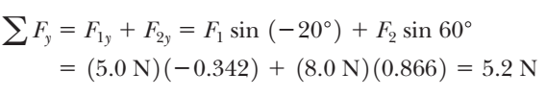
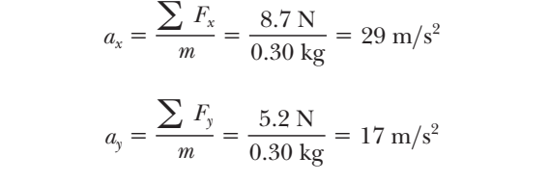
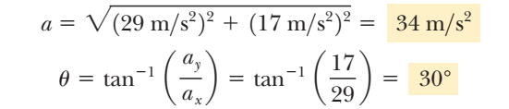
Solution:

Slide 19
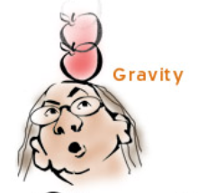
Gravitational Force
Gravitational force is a vector
Expressed by Newton’s Law of Universal Gravitation:
G – gravitational constant
M – mass of the Earth
m – mass of an object
R – radius of the Earth
Direction: pointing downward
Notes:
19

Slide 20
Weight
The magnitude of the gravitational force acting on an object of mass m near the Earth’s surface is called the weight w of the object: w = mg
g can also be found from the Law of Universal Gravitation
Weight has a unit of N
Weight depends upon location
R = 6,400 km
Notes:
20

Slide 21
Quick Quiz 5.4
Suppose you are talking by interplanetary telephone to a friend, who lives on the Moon. He tells you that he has just won a newton of gold in a contest. Excitedly, you tell him that you entered the Earth version of the same contest and also won a newton of gold! Who is richer? (a) You are. (b) Your friend is. (c) You are equally rich.
Solution: (b). Because the value of g is smaller on the Moon than on the Earth, more mass of gold would be required to represent 1 newton of weight on the Moon. Therefore, your friend on the Moon is richer, by about a factor of 6!
Notes:
9.8/6 (g moon1.6)
21

Slide 22
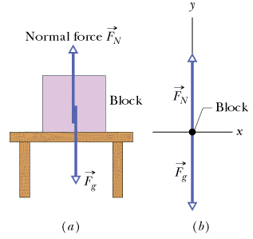
Normal Force
Force from a solid surface which keeps object from falling through
Direction: always perpendicular to the surface
Magnitude: depends on situation
Notes:
22

Slide 23
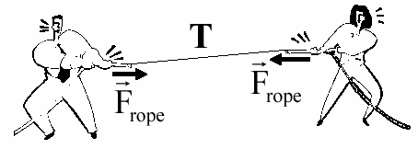

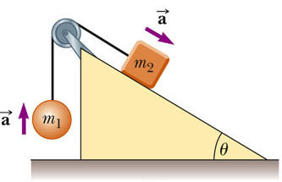
Tension Force: T
A taut rope exerts forces on whatever holds its ends
Direction: always along the cord (rope, cable, string ……) and away from the object
Magnitude: depend on situation
T1
T1 = T = T2
T2
Notes:
23
The force the rope exerts is away from the object and parallel to the rope
When a rope attached to an object is pulling it, the magnitude of that force is the tension in the rope

Slide 24
Newton’s Third Law
If object 1 and object 2 interact, the force exerted by object 1 on object 2 is equal in magnitude but opposite in direction to the force exerted by object 2 on object 1
Equivalent to saying a single isolated force cannot exist
Feb. 11-15, 2013
Notes:
24

Slide 25
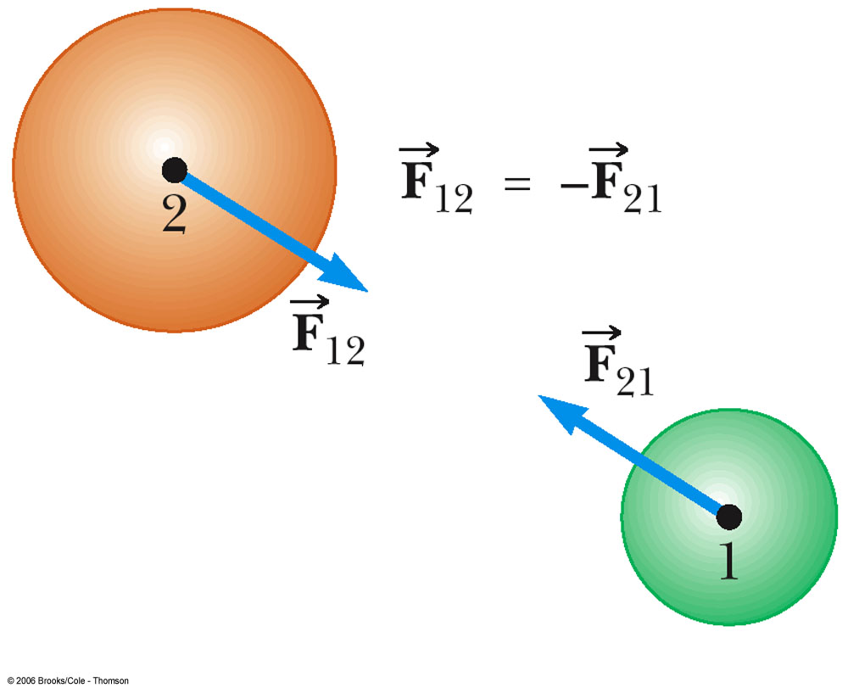
Newton’s Third Law cont.
F₁₂ may be called the action force and F₂₁ the reaction force
Actually, either force can be the action or the reaction force
The action and reaction forces act on different objects
Notes:
25

Slide 26
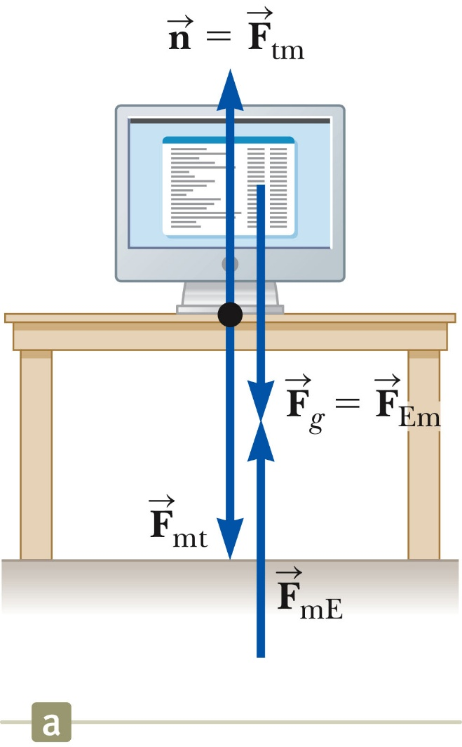
Action-Reaction Examples, 2
When a computer monitor is at rest on a table, the forces acting on the monitor are the normal force n and the gravitational force F_{g}.
The reaction to n is the force F_{mt} exerted by the monitor on the table. The reaction to F_{g} is the force F_{mE} exerted by the monitor on the Earth.
Remember that Newton’s third law action and reaction forces act on different objects. For example, in Figure 5.6,
The forces and are equal in magnitude and opposite in direction, but they do not represent an action-reaction pair because both forces act on the same object, the monitor.
Section 5.6

Slide 27
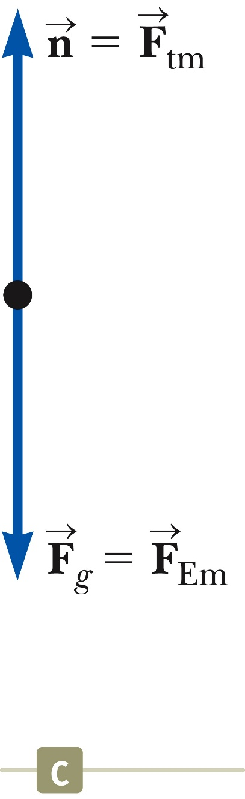
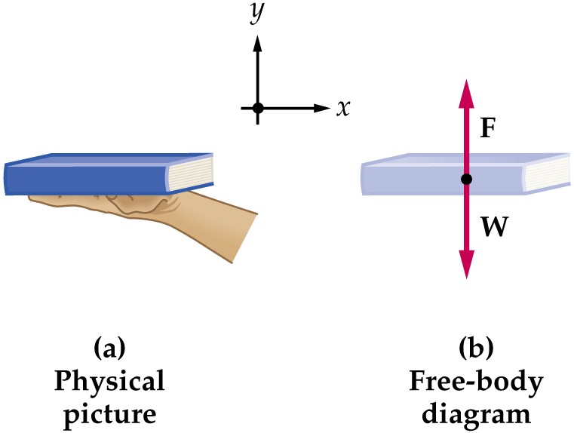
Free Body Diagram
The most important step in solving problems involving Newton’s Laws is to draw the free body diagram (FBD).
Be sure to include only the forces acting on the object of interest.
Include any field forces acting on the object.
Do not assume the normal force equals the weight.
Section 5.6

Slide 28
Conceptual Example 5.3 You Push Me and I’ll Push You
A large man and a small boy stand facing each other on frictionless ice. They put their hands together and push against each other so that they move apart.
Who moves away with the higher speed?
Who moves farther while their hands are in contact?
Solution (A): smaller mass, experiences the greater acceleration. Both individuals accelerate for the same amount of time, but the greater acceleration of the boy over this time interval results in his moving away from the interaction with the higher speed , since .
Solution (B): Because the boy has the greater acceleration and therefore the greater average velocity, he moves farther than the man during the time interval during which their
hands are in contact.

Slide 29
Hints for Problem-Solving
Read the problem carefully at least once
Draw a picture of the system, identify the object of primary interest, and indicate forces with arrows
Label each force in the picture in a way that will bring to mind what physical quantity the label stands for (e.g., T for tension)
Draw a free-body diagram of the object of interest, based on the labeled picture. If additional objects are involved, draw separate free-body diagram for them
Choose a convenient coordinate system for each object
Apply Newton’s second law. The x- and y-components of Newton second law should be taken from the vector equation and written individually. This often results in two equations and two unknowns
Solve for the desired unknown quantity, and substitute the numbers
Feb. 11-15, 2013

Slide 30
Objects in Equilibrium
Objects that are either at rest or moving with constant velocity are said to be in equilibrium
Acceleration of an object can be modeled as zero:
Mathematically, the net force acting on the object is zero
Equivalent to the set of component equations given by

Slide 31
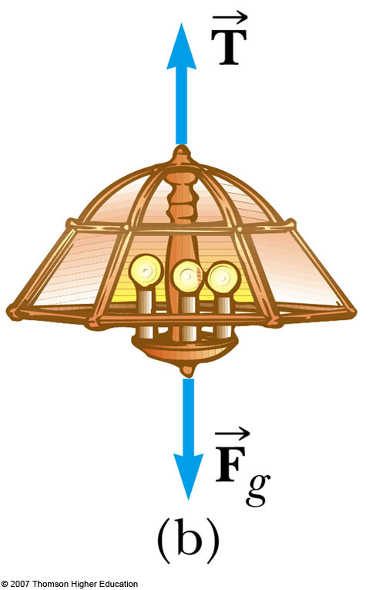
Equilibrium, Example 1
A lamp is suspended from a chain of negligible mass
The forces acting on the lamp are
the downward force of gravity
the upward tension in the chain
Applying equilibrium gives

Slide 32
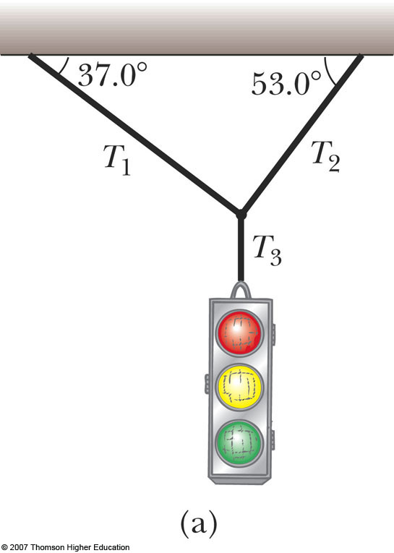
Equilibrium, Example 2
A traffic light weighing 100 N hangs from a vertical cable tied to two other cables that are fastened to a support. The upper cables make angles of 37 and 53 with the horizontal. Find the tension in each of the three cables.
Conceptualize the traffic light
Assume cables don’t break
Nothing is moving
Categorize as an equilibrium problem
No movement, so acceleration is zero
Model as an object in equilibrium

Slide 33
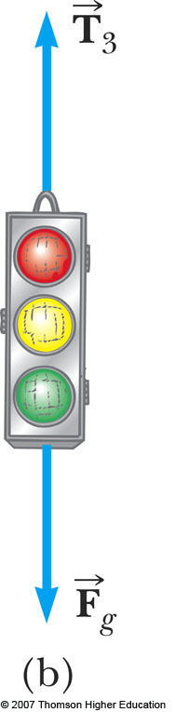
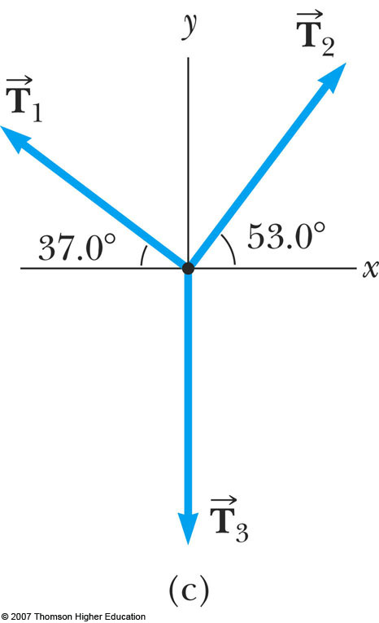
Equilibrium, Example 2
Need 2 free-body diagrams
Apply equilibrium equation to light
Apply equilibrium equations to knot
Notes:
33
Analyze, cont.
Find T₃ from applying equilibrium in the y-direction to the light
Find T₁ and T₂ from applying equilibrium in the x- and y-directions to the knot
Finalize
Think about different situations and see if the results are reasonable

Slide 34
Accelerating Objects
If an object that can be modeled as a particle experiences an acceleration, there must be a nonzero net force acting on it
Draw a free-body diagram
Apply Newton’s Second Law in component form
Feb. 11-15, 2013

Slide 35
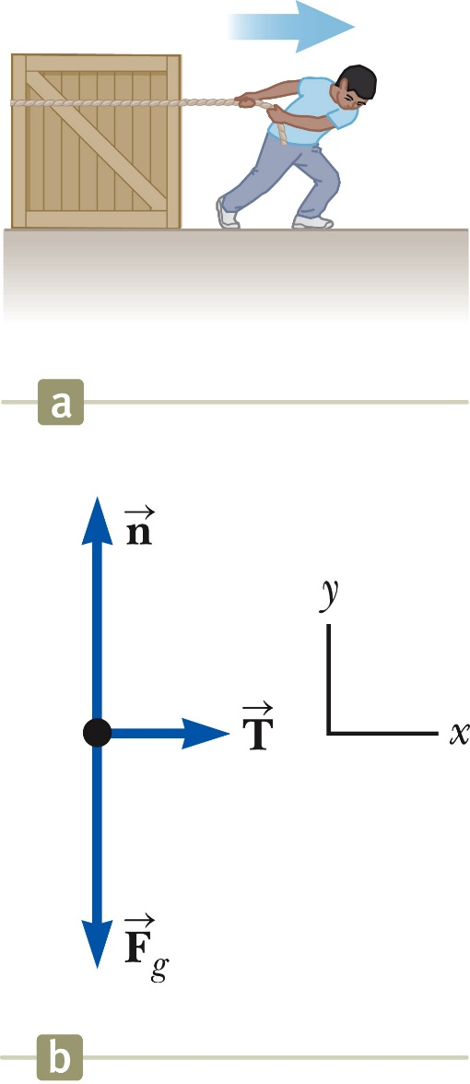
Newton’s Second Law, Example 1
Forces acting on the crate:
A tension, acting through the rope, is the magnitude of force
The gravitational force,
The normal force, , exerted by the floor
Apply Newton’s Second Law in component form:
Section 5.7

Slide 36

Accelerating Objects, Example 1
A man weighs himself with a scale in an elevator. While the elevator is at rest, he measures a weight of 800 N.
What weight does the scale read if the elevator accelerates upward at 2.0 m/s²? a = 2.0 m/s²
What weight does the scale read if the elevator accelerates downward at 2.0 m/s²? a = - 2.0 m/s²
Upward:
Downward:
N
N
mg
mg

Slide 37
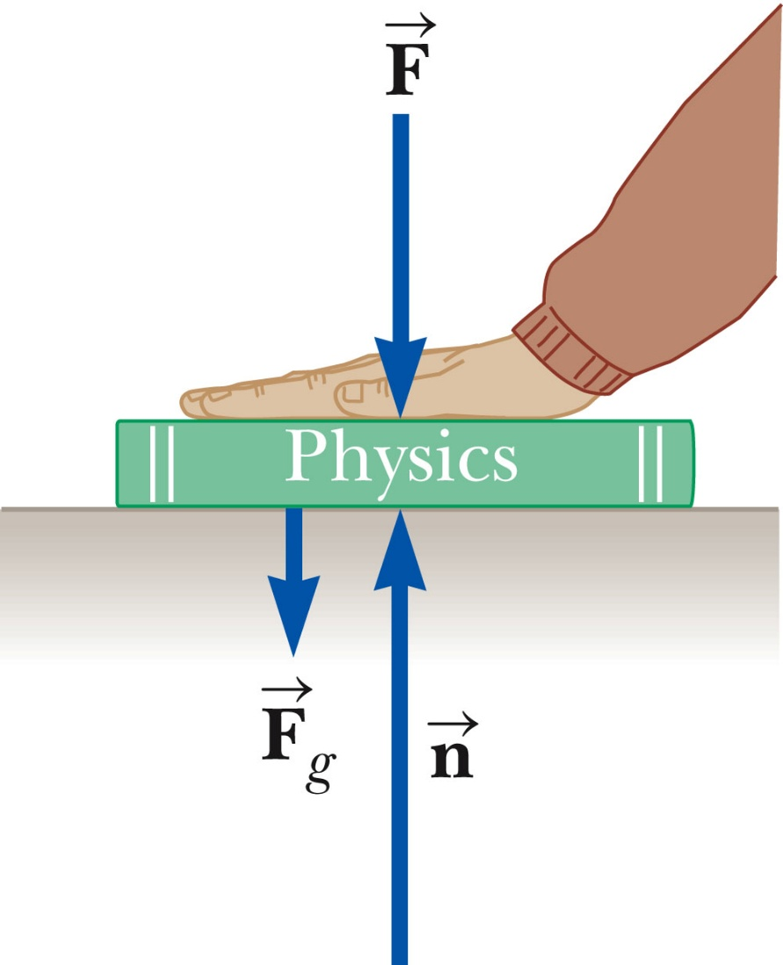
Note About the Normal Force
The normal force is not always equal to the gravitational force of the object.
For example, in this case
may also be less than
Section 5.7

Slide 38
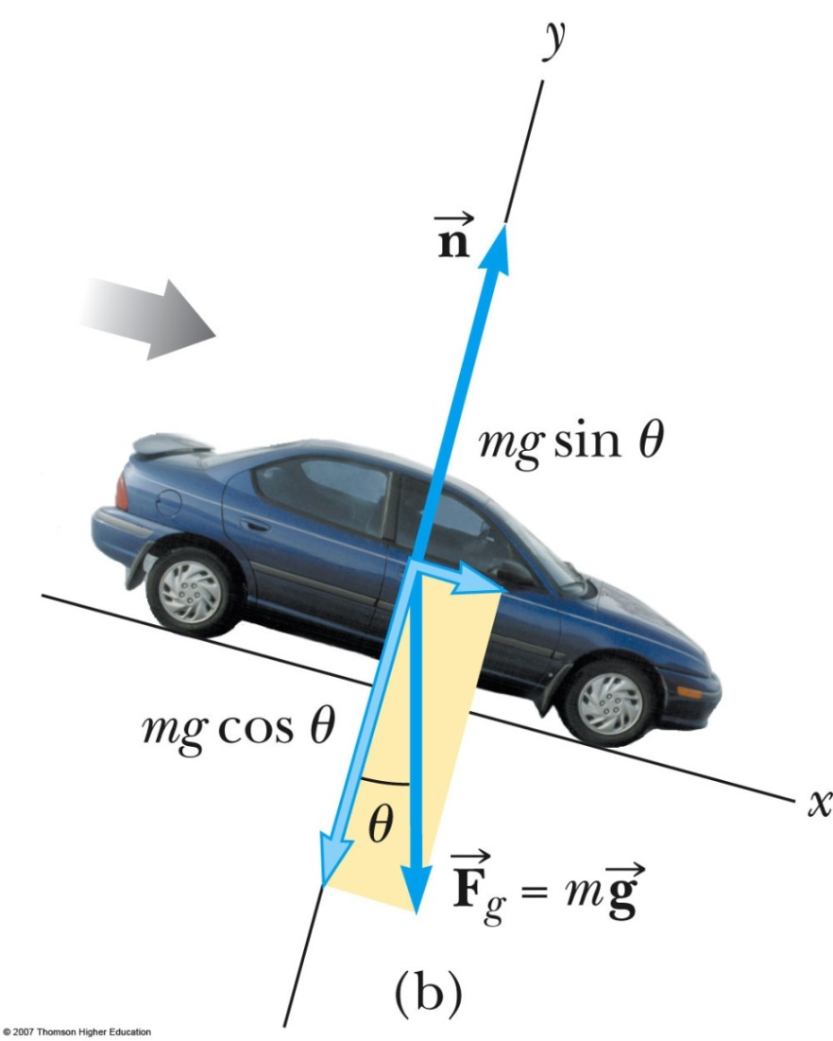
Problem 5.6 The Runway Car
A car of mass m is on an icy driveway inclined at an angle θ as in Figure 5.11a.
Find the acceleration of the car, assuming that the driveway is frictionless.
Suppose the car is released from rest at the top of the incline and the distance from the car’s front bumper to the bottom of the incline is d. How long does it take the front bumper to reach the bottom of the hill, and what is the car’s speed as it arrives there?

Slide 39
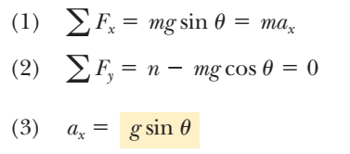
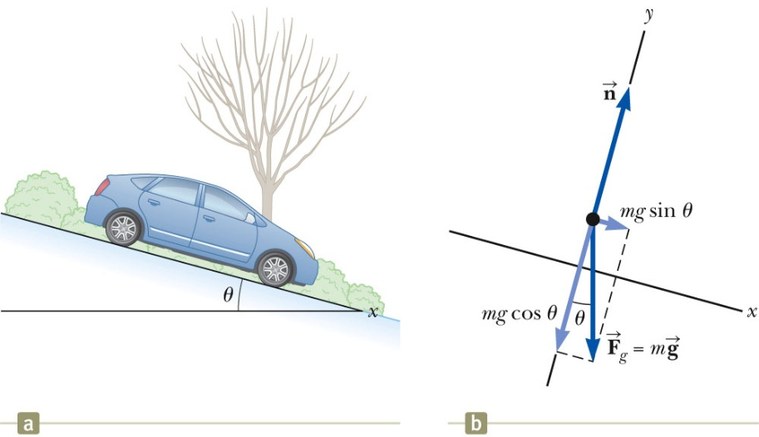
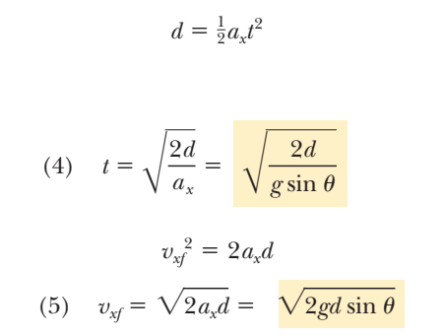
Problem 5.6 The Runway Car
Section 5.7

Slide 40
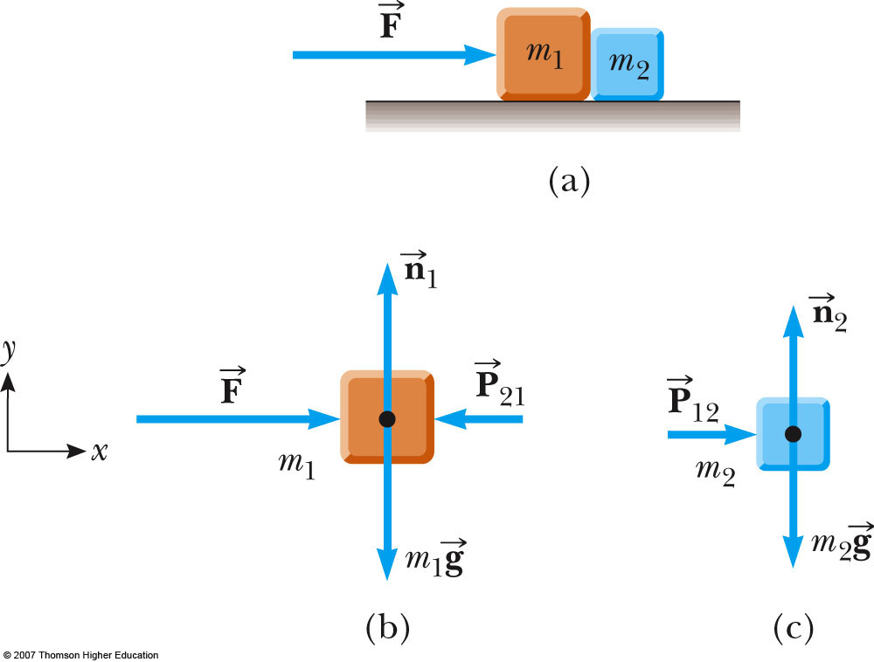
Problem 5.7: One Block Pushes Another
Two blocks of masses m₁ and m₂, with m₁ > m₂, are placed in contact with each other on a frictionless, horizontal surface as in Active Figure.
A constant horizontal force is applied to m₁ as shown.
(a) Find the magnitude of the acceleration of the system.
(b) Determine the magnitude of the contact force between the two blocks.
Section 5.7

Slide 41
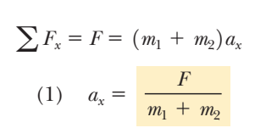
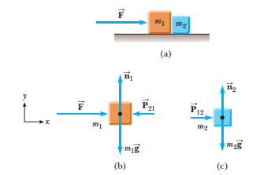
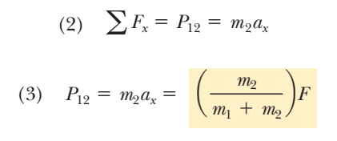
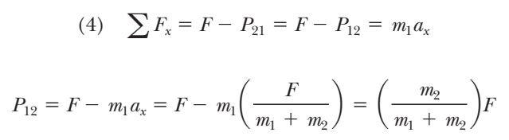
Solution:

Slide 42
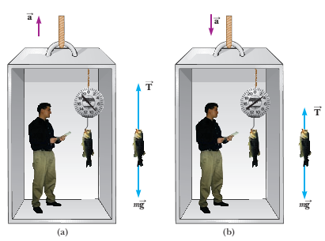
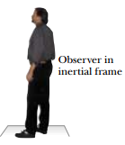
Problem 5.8: Apparent weight versus true weight
A person weighs a fish of mass m on a spring scale attached to the ceiling of an elevator as illustrated in Figure.
(A) Show that if the elevator accelerates either upward or downward, the spring scale gives a reading that is different from the weight of the fish.
(B) Evaluate the scale readings for a 40.0-N fish if the elevator moves with an acceleration a_{y} =±2.00 m/s².

Slide 43
Problem 5.8 Weighing a Fish in an Elevator
What If? Suppose the elevator cable breaks and the elevator and its contents are in free-fall .What happens to the reading on the scale?
Answer: If the elevator falls freely, its acceleration is ay = -g. We see from (2)
T = m(g-ay), that the scale reading T is zero in this case; that is, the fish appears to be weightless.

Slide 44
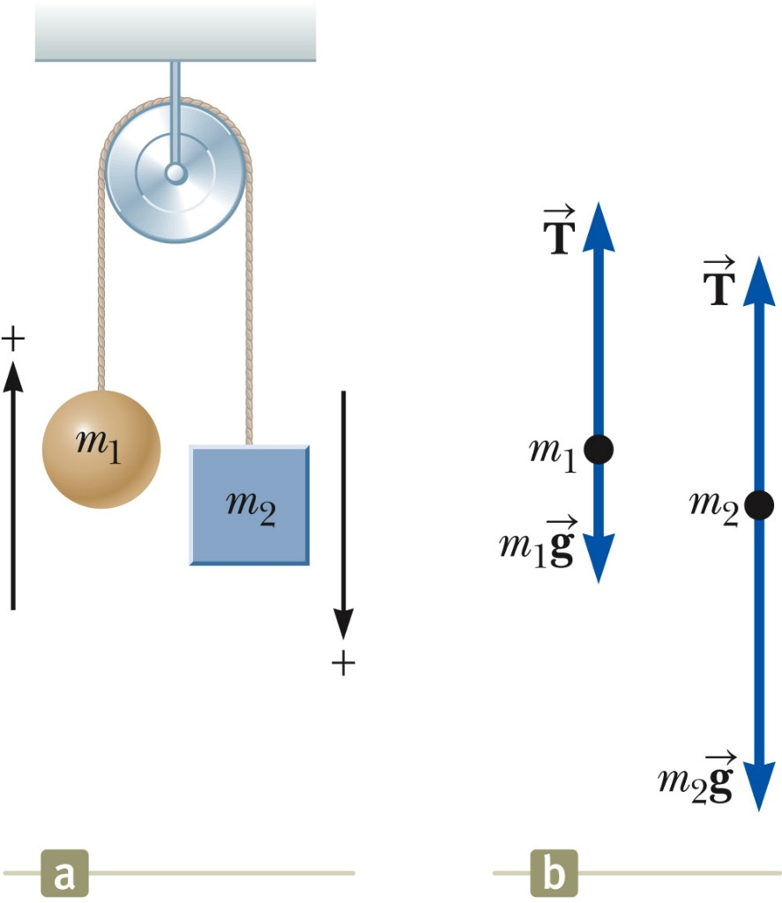
Problem 5.9: The Atwood’s Machine
When two objects of unequal mass are hung vertically over a frictionless pulley of negligible mass as in Active Figure, the arrangement is called an Atwood machine.
The device is sometimes used in the laboratory to calculate the value of g.
Determine the magnitude of the acceleration of the two objects and the tension in the lightweight cord.
Section 5.7

Slide 45




Solution:
Section 5.7

Slide 46


Solution:
Section 5.7

Slide 47
Problem 5.9: The Atwood’s Machine
What If? (A) Describe the motion of the system if the objects have equal masses, that is, m₁= m₂.
(B) Describe the motion of the system if one of the masses is much larger than the other, m₁>> m₂
Section 5.7

Slide 48
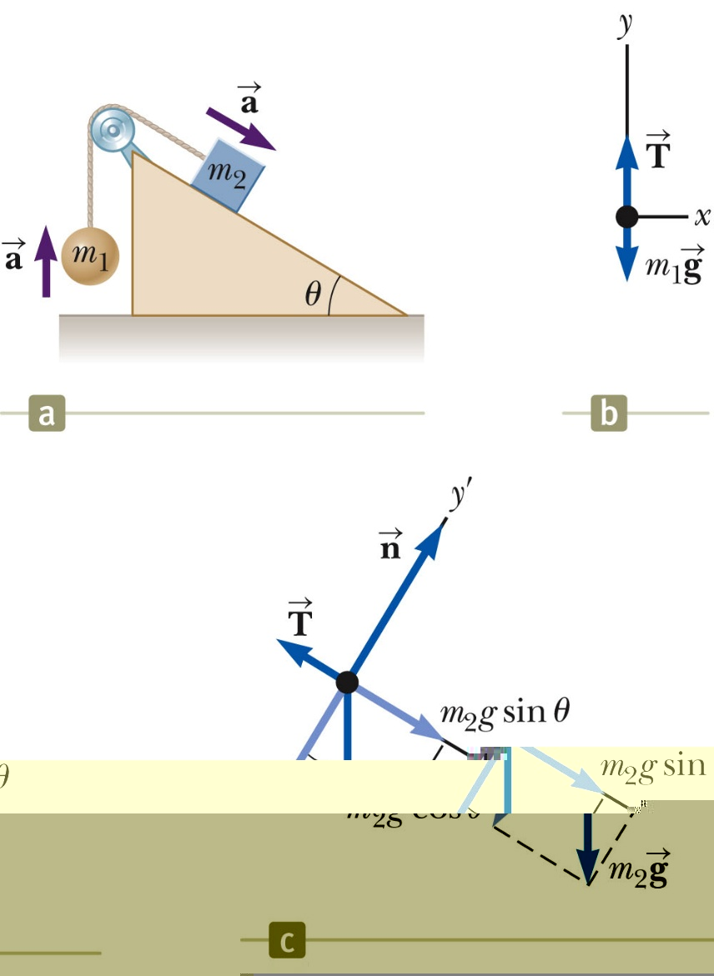
Problem 5.10: Acceleration of two Objects connected by a cord
A ball of mass m₁ and a block of mass m₂ are attached by a lightweight cord that passes over a frictionless pulley of negligible mass as in Figure.
The block lies on a frictionless incline of angle θ.
Find the magnitude of the acceleration of the two objects and the tension in the cord.
Section 5.7

Slide 49
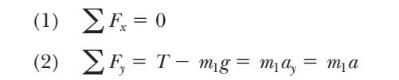
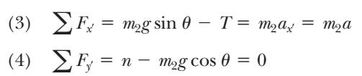
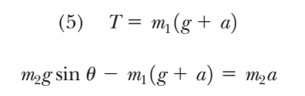
Solution:
Section 5.7

Slide 50


Solution:
Section 5.7

Slide 51
Solution:
What If? (A) What happens in this situation if the angle θ = 90° ?
(B) What happens if the mass m₁= 0?

Slide 52

Solution:

Slide 53
Forces of Friction
When an object is in motion on a surface or through a viscous medium, there will be a resistance to the motion. This is due to the interactions between the object and its environment.
This resistance is called the force of friction.
Forces of friction are very important in our everyday lives. They allow us to walk or run and are necessary for the motion of wheeled vehicles.

Slide 54

The trash can remains stationary if F is small. The force that counteracts F and keeps the trash can from moving is called the force of static friction f_{s} . As long as the can is not moving f_{s} = F .
Thus, if F is increased f_{s} , also increased and vise versa.
If we increase the magnitude of F, as in figure (b), the trash can then eventually slips. When the can trash is on the verge of slipping f_{s} , has its maximum f_{s,max} , as shown in figure.

Slide 55
When F exceeds f_{s,max} , the trash can moves and accelerates , when the trash can is in motion, the friction force is less than f_{s,max} , as can be viewed.
The force of friction experienced by an object in motion is called force of kinetic friction
If F = f_{k} the acceleration is zero and the trash can moves to the right with constant speed.
If the applied force is removed from the moving can, the friction force acting to the left provides an acceleration of the trash can in the x direction and eventually brings it to rest, again consistent with Newton’s second law.

Slide 56

Applying Newton's Laws
As the figure below indicates, the force of kinetic friction is proportional to the normal force: Doubling the normal force doubles the force of kinetic friction.
© 2014 Pearson Education, Inc.
Notes:
56

Slide 57

Kinetic Friction
Kinetic friction is the friction encountered when surfaces slide against one another.
The magnitude of the force of kinetic friction depends on the normal force.
The larger the coefficient of friction, the greater the force of friction. As the table below indicates, µ_{k} depends on the two interacting surfaces.
© 2014 Pearson Education, Inc.
Notes:
57

Slide 58

Static Friction
The maximum force that static friction can exert is given by the following expression:
Notes:
58

Slide 59
Forces of Friction
Experimentally, to a good approximation, both, and are proportional to the magnitude of the normal force.
The magnitude of static friction in between any two surfaces in contact can have
is the coefficient of static friction
For static friction, the equals sign is holds only when the surfaces of the verge of slipping that is when
Inequality holds for static friction if the surfaces are not on the verge of slipping.
The magnitude of kinetic friction acting between two surfaces is ,
, is called coefficient of kinetic friction
Section 5.8

Slide 60

Some Coefficients of Friction
Section 5.8

Slide 61

Friction Problem 1
The following is a simple method of measuring coefficients of friction: Suppose a block is placed on a rough surface inclined relative to the horizontal, as shown in Figure.
The incline angle is increased until the block starts to move. Show that by measuring the critical angle at which this slipping just occurs, we can obtain .
Section 5.8

Slide 62



Solution:

Slide 63

Friction, Problem 2
A hockey disk on a frozen pond is given an initial speed of 20.0 m/s. If the disk always remains on the ice and slides 115 m before coming to rest, determine the coefficient of kinetic friction between the disk and ice.

Slide 64






Friction, Problem 2

Slide 65

Friction, Problem 3
A block of mass m₁ on a rough, horizontal surface is connected to a ball of mass m₂ by a light weight cord over a lightweight, frictionless pulley, as shown in Figure. A force of magnitude F at an angle θ with the horizontal is applied to the block as shown. The coefficient of kinetic friction between the block and surface is μ_{k}. Determine the magnitude of the acceleration of the two objects
Section 5.8

Slide 66







Friction, Problem 3
Section 5.8

Slide 67
Assignment # 02
12, 16, 20, 21, 23, 26, 28, 31, 42, 43, 45, 54, 57, 61
Note: Quiz will be held in 2nd class of next week and will cover chapter 5.

